Slide 1

Performance and Scalability of DMN-Based LCNC Platforms
October 2023

Slide 2
Content
What is DMN?
Overall structure of jDMN
Transpiler to Java / Kotlin / Python
Code optimisation
Q&As

Slide 3
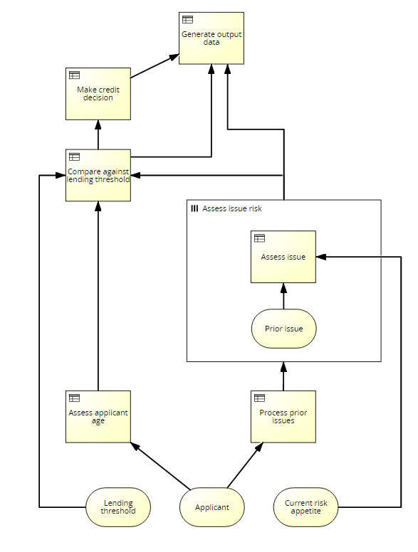
What is DMN?
Decision Model and Notation (DMN)
Standard published by OMG
Notation to support decision management and business rules
Users
Business People: manage and monitor decisions
BAs or Functional Analysists: specify decision models
Technical developers: execution and automation
DSL
Diagrammatic notation
Templates
Expression language FEEL
Standalone or with BPMN & CMMN

Slide 4
Overall Structure
DMN Processors
Reader / Writer
Validators
Transformers
Interpreter
Translator
Dialects
DMN 1.1 – 1.5
Signavio

Slide 5
Overall Structure
Syntax Analyzer
Source
Text
Lexical Analyzer
Source
Tokens
Parser
AST
Semantic Analyzer
Error Manager
& Logger
Semantic
Tree
Code
Generator
Interpreter

Slide 6
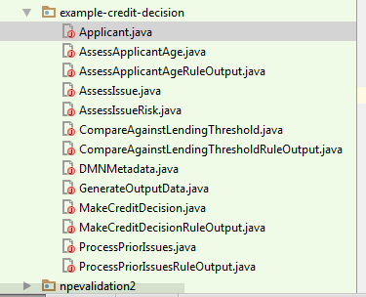
Translation

Slide 7
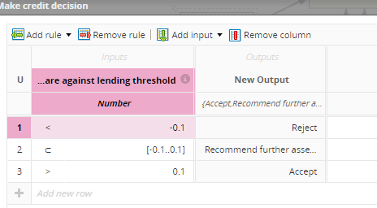
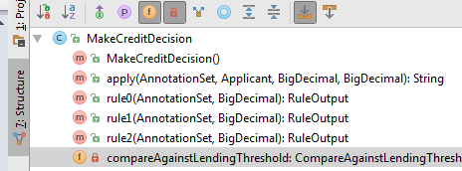
Translation

Slide 8
Translation
How did we built it?
Syntax-Driven Translation Schematas (SDTS)
Based on Knuth’s attributed gramars
Synthesized attributes
Inherited Attributes
Expr₁ → Expr₂ + Term { Expr₁.value = Expr₂.value + Term.value }
Expr → Term { Expr.value = Term.value }
Term₁ → Term₂ * Factor { Term₁.value = Term₂.value * Factor.value }
Term → Factor { Term.value = Factor.value }
Factor → "(" Expr ") { Factor.value = Expr.value }
Factor → integer { Factor.value = strToInt(integer.str) }

Slide 9
Translation
Advantages include
Performance: we have seen runtimes 4-10 times faster than previous engine execution in complex decision tests
Stability: given that we now control the code generation, we are able to resolve issues without relying on the vendor
Functionality: the fact that we control the code generation means that we are also able to enable more advanced functionality for DMN/Java models

Slide 10
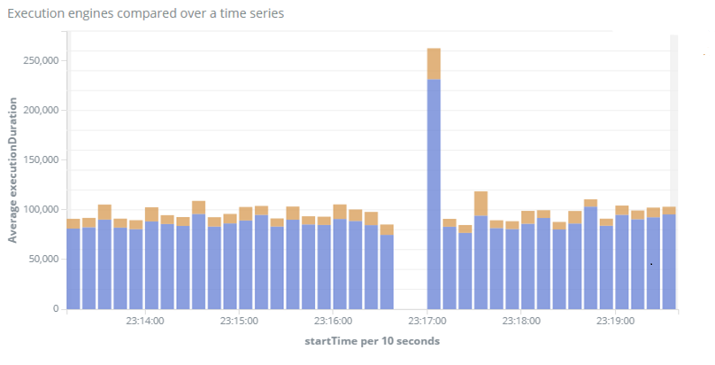
Performance
jDMN
Previous

Slide 11






Code Optimisation – Model Level
AWS Lambda
gRPC / protobuf
AWS Stack
Message Bus
Users

Slide 12
Code Optimisation – DRG Element Level
Caching
Map-reduce for
MID

Slide 13
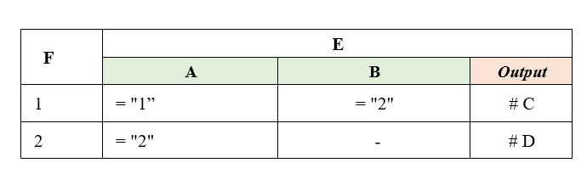
Code Optimisation – DRG Element Level
Lazy evaluation
Inner nodes (Decisions, BKMs, Decision Services)
Leaves (Input Data)

Slide 14
Code Optimisation – DRG Element Level
Performance Before DRG Optimization
Decision Name | Request Count | Response Time 90th (ms) | Min Response Time (ms) | Max Response Time (ms)
D1 | 12899 | 40 | 4 | 5562
D2 | 361 | 6676 | 21 | 9653
D3 | 28731 | 15 | 1 | 933
D4 | 86165 | 39 | 4 | 6367
Performance After DRG Optimization
Decision Name | Request Count | Response Time 90th (ms) | Min Response Time (ms) | Max Response Time (ms)
D1 | 12899 | 35 | 5 | 7150
D2 | 361 | 315 | 153 | 4603
D3 | 28745 | 12 | 1 | 606
D4 | 86204 | 37 | 4 | 7736

Slide 15
Code Optimisation at FEEL level
Native Types
Built-in functions
Native Compiler / Interpreter (e.g. JIT compiler)

Slide 16
What next?
Enhance lazy evaluation
Three Address Code optimization

Slide 17

Questions?
https://github.com/goldmansachs/jdmn

